Slide 1
INTRODUCTION TO COMPUTING
Course Code: CCINCOM/L
Model Free Control
Elizer Ponio Jr.
Faculty Member
Department of Computer Science
College of Computing and Information Technologies (CCIT)
National University
Joseph Marvin R. Imperial
REINFORCEMENT LEARNING
NU College of Computing and Information Technologies
Course Code: CCRNFLRL

Slide 2
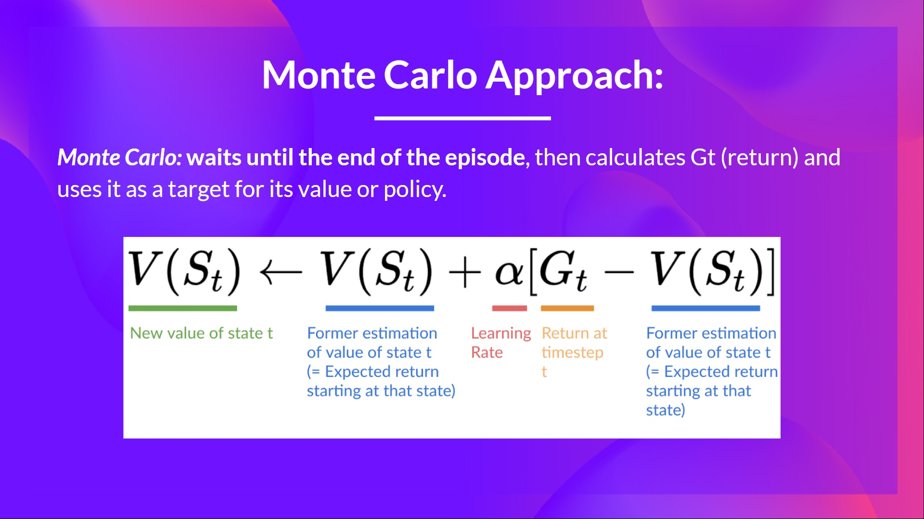
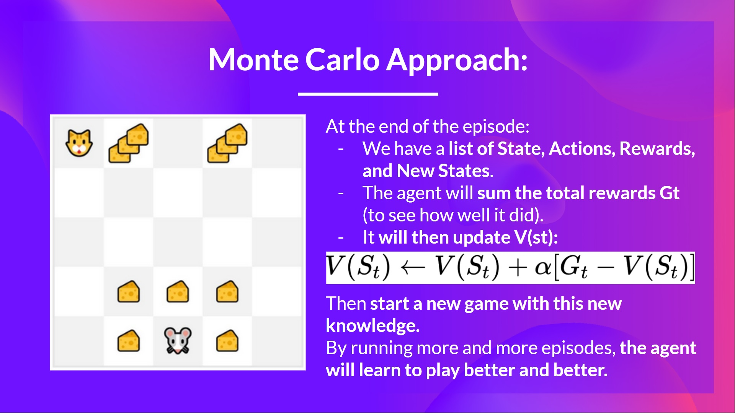
Refresher
INTRODUCTION TO COMPUTING
Course Code: CCINCOM/L
Joseph Marvin R. Imperial
REINFORCEMENT LEARNING
NU College of Computing and Information Technologies
Course Code: CCRNFLRL

Slide 3
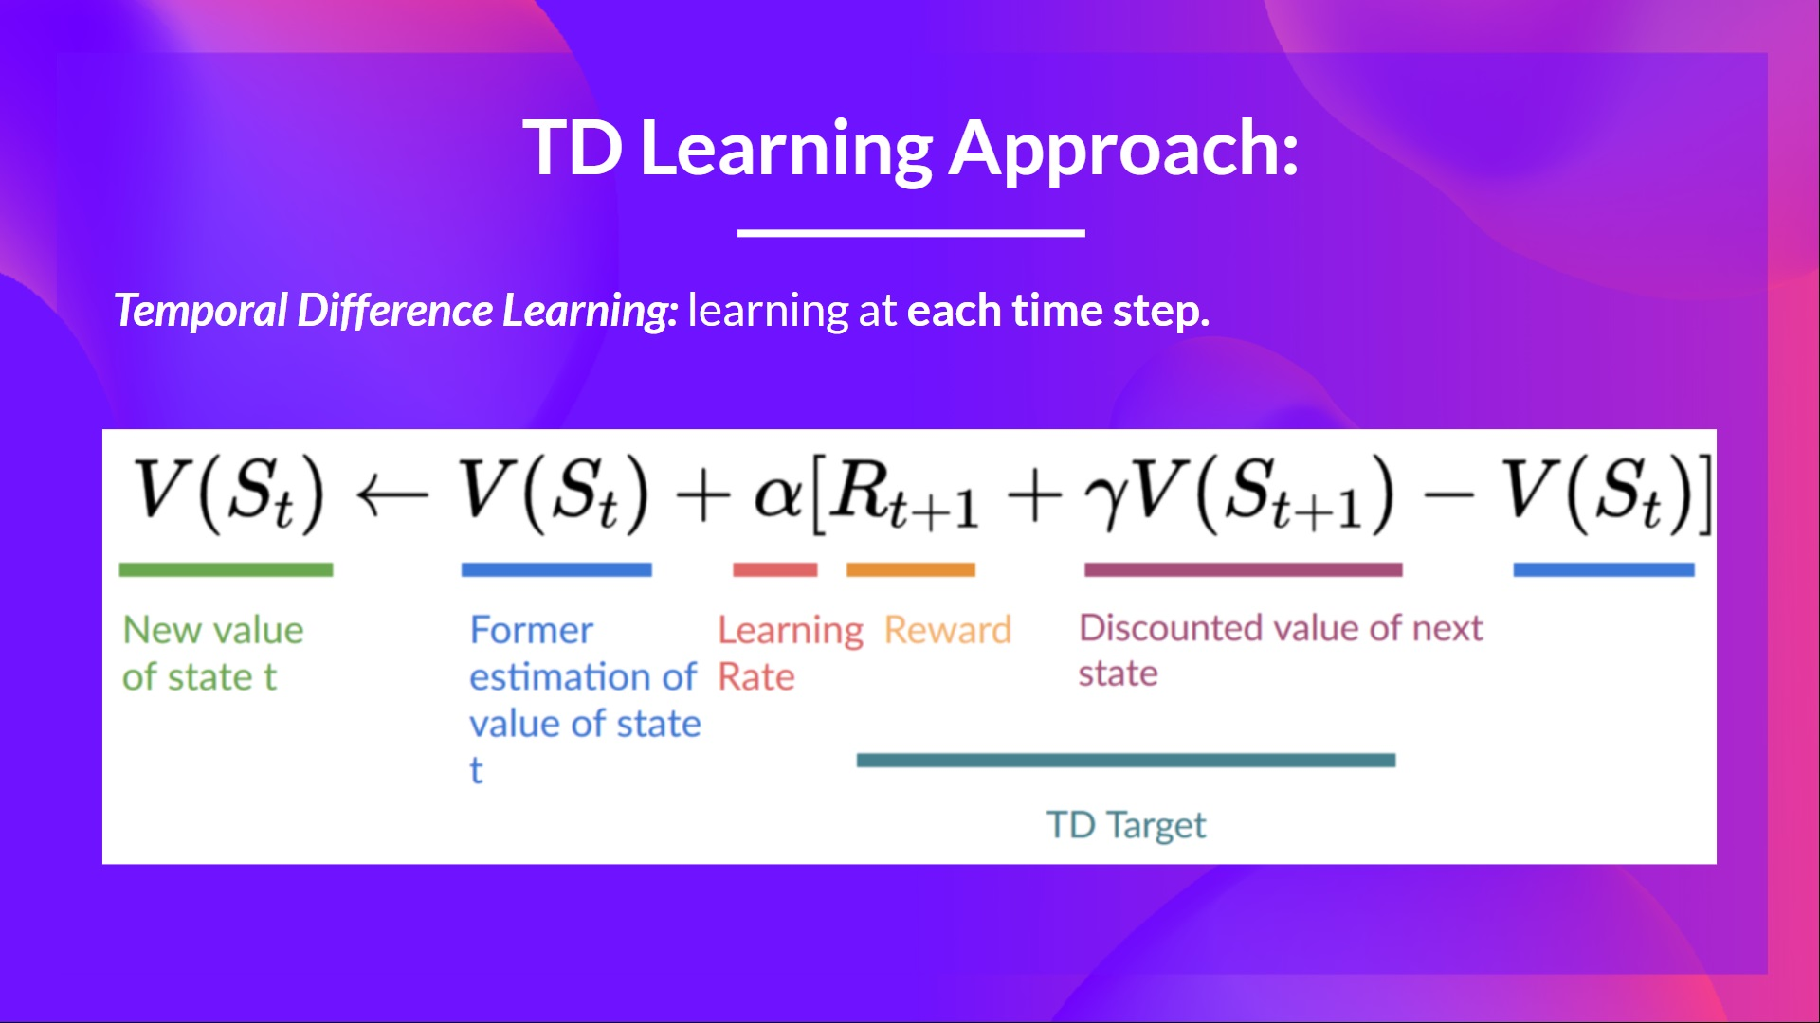
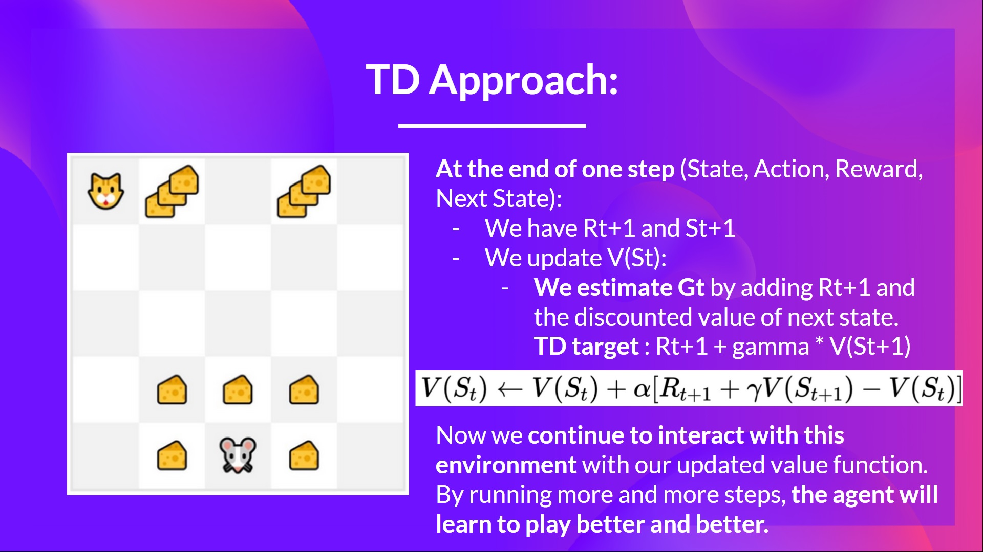
Refresher
INTRODUCTION TO COMPUTING
Course Code: CCINCOM/L
Joseph Marvin R. Imperial
REINFORCEMENT LEARNING
NU College of Computing and Information Technologies
Course Code: CCRNFLRL

Slide 4
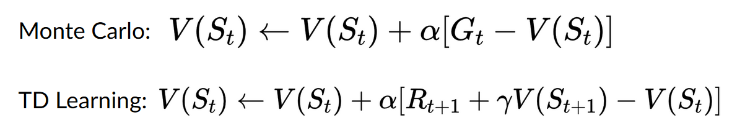
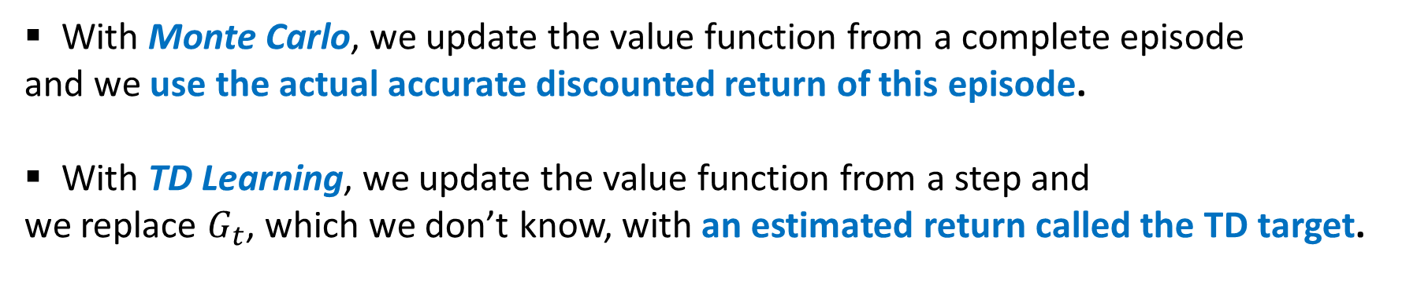
Refresher
INTRODUCTION TO COMPUTING
Course Code: CCINCOM/L
With Monte Carlo, we update the value function from a complete episode
and we use the actual accurate discounted return of this episode.
With TD Learning, we update the value function from a step and
we replace $G_{t}$, which we don’t know, with an estimated return called the TD target.
Joseph Marvin R. Imperial
REINFORCEMENT LEARNING
NU College of Computing and Information Technologies
Course Code: CCRNFLRL

Slide 5
Outline
INTRODUCTION TO COMPUTING
Course Code: CCINCOM/L
Introduction
On-Policy and Off-Policy
ε-Greedy Exploration
On-Policy
GLIE Monte-Carlo
SARSA
Off-Policy
Q-Learning
Joseph Marvin R. Imperial
REINFORCEMENT LEARNING
NU College of Computing and Information Technologies
Course Code: CCRNFLRL

Slide 6
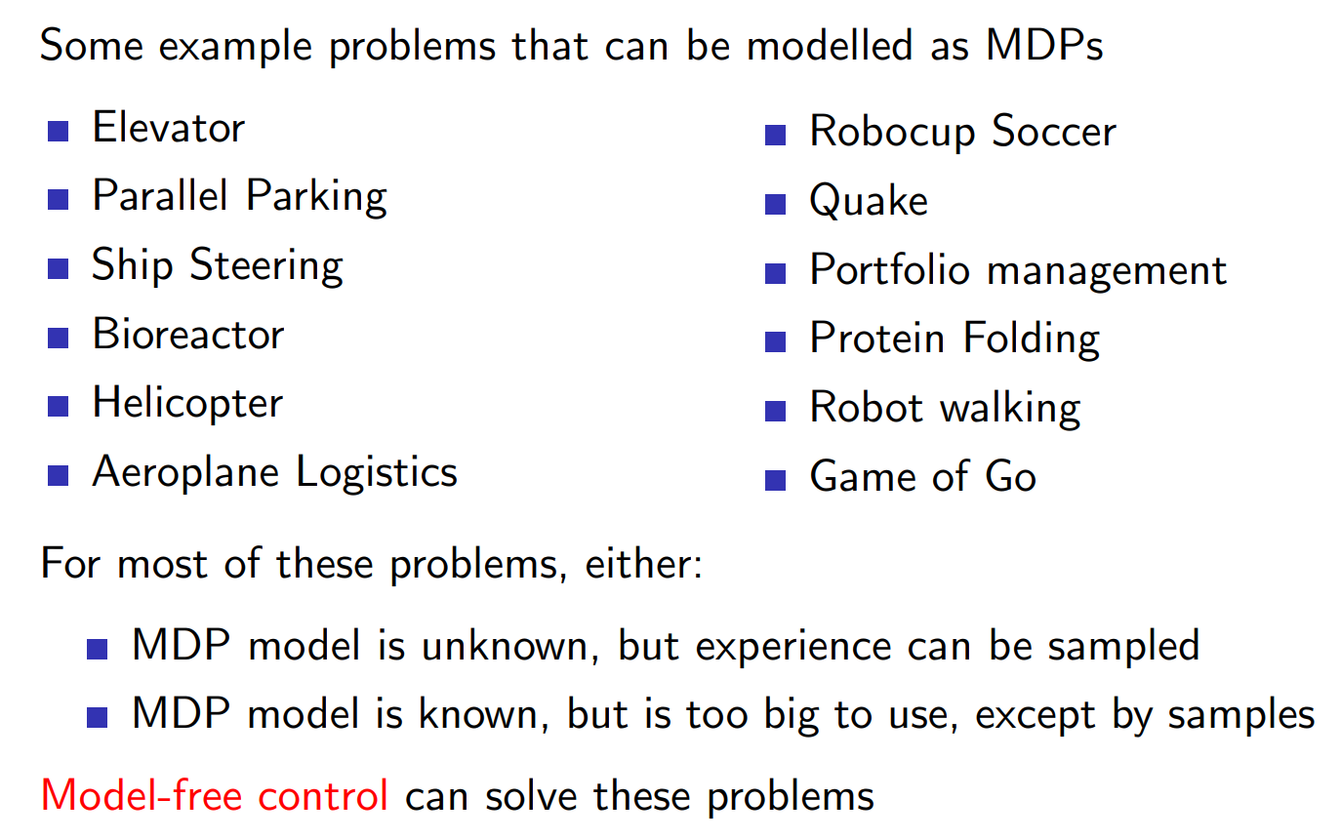
Uses of Model-Free Control
INTRODUCTION TO COMPUTING
Course Code: CCINCOM/L
Joseph Marvin R. Imperial
REINFORCEMENT LEARNING
NU College of Computing and Information Technologies
Course Code: CCRNFLRL

Slide 7
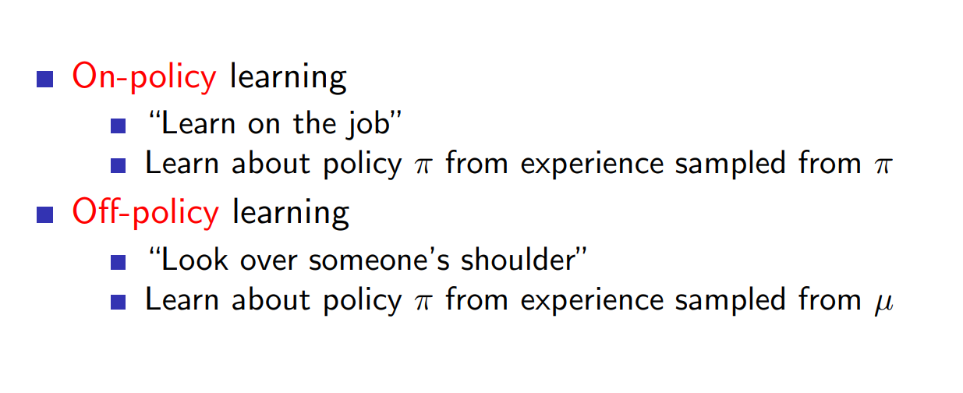
On-Policy and Off-Policy
INTRODUCTION TO COMPUTING
Course Code: CCINCOM/L
Joseph Marvin R. Imperial
REINFORCEMENT LEARNING
NU College of Computing and Information Technologies
Course Code: CCRNFLRL

Slide 8
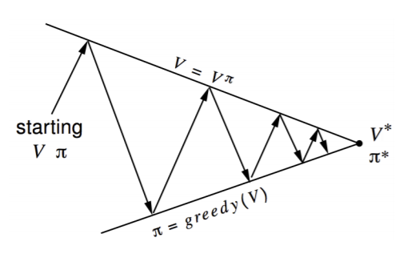
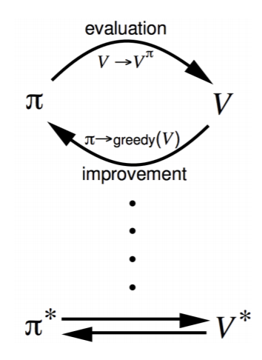
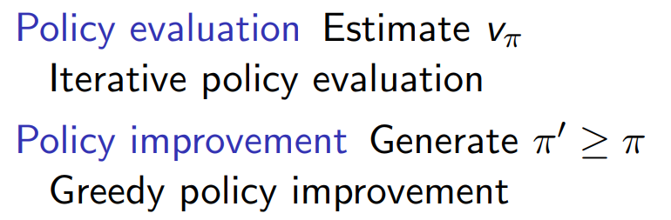
Generalised Policy Iteration (Refresher)
INTRODUCTION TO COMPUTING
Course Code: CCINCOM/L
Joseph Marvin R. Imperial
REINFORCEMENT LEARNING
NU College of Computing and Information Technologies
Course Code: CCRNFLRL

Slide 9
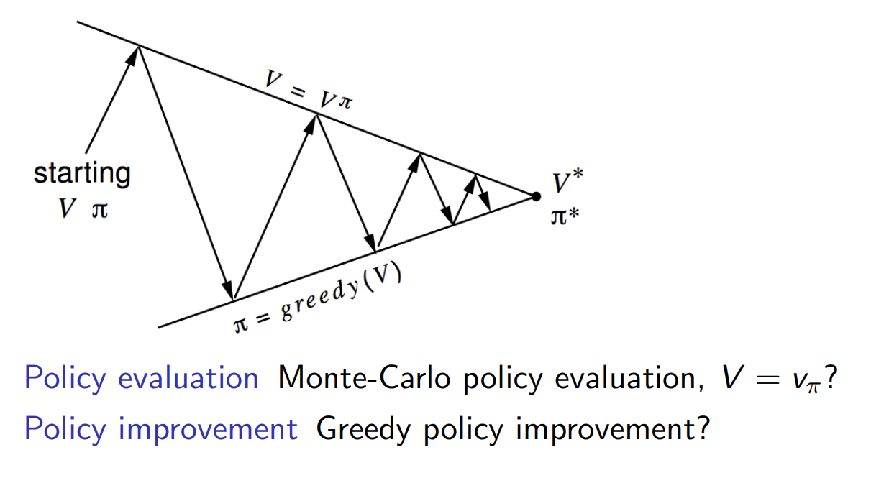
Generalised Policy Iteration with Monte-Carlo
INTRODUCTION TO COMPUTING
Course Code: CCINCOM/L
Joseph Marvin R. Imperial
REINFORCEMENT LEARNING
NU College of Computing and Information Technologies
Course Code: CCRNFLRL

Slide 10
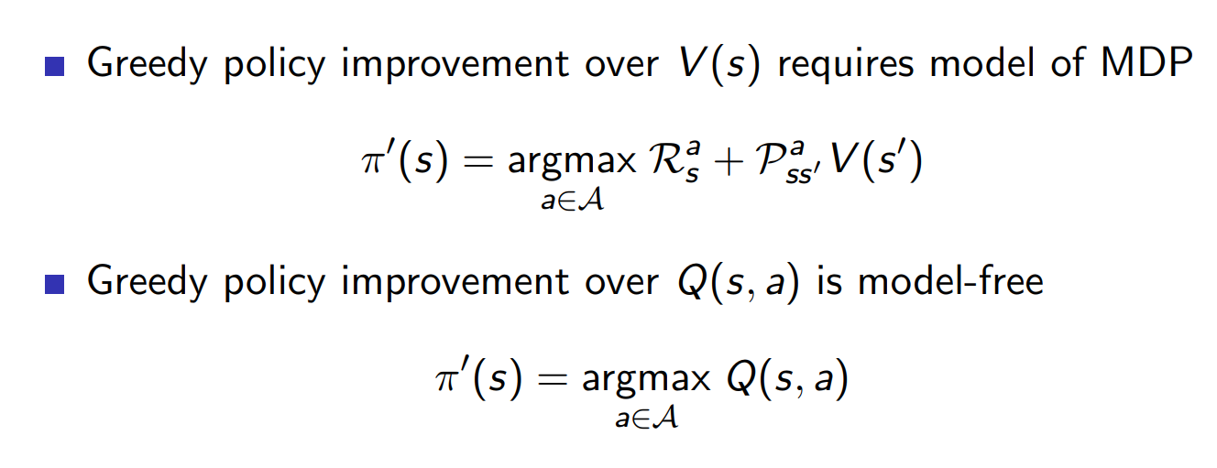
Model Free Policy Iteration using Action-Value Function
INTRODUCTION TO COMPUTING
Course Code: CCINCOM/L
Joseph Marvin R. Imperial
REINFORCEMENT LEARNING
NU College of Computing and Information Technologies
Course Code: CCRNFLRL

Slide 11
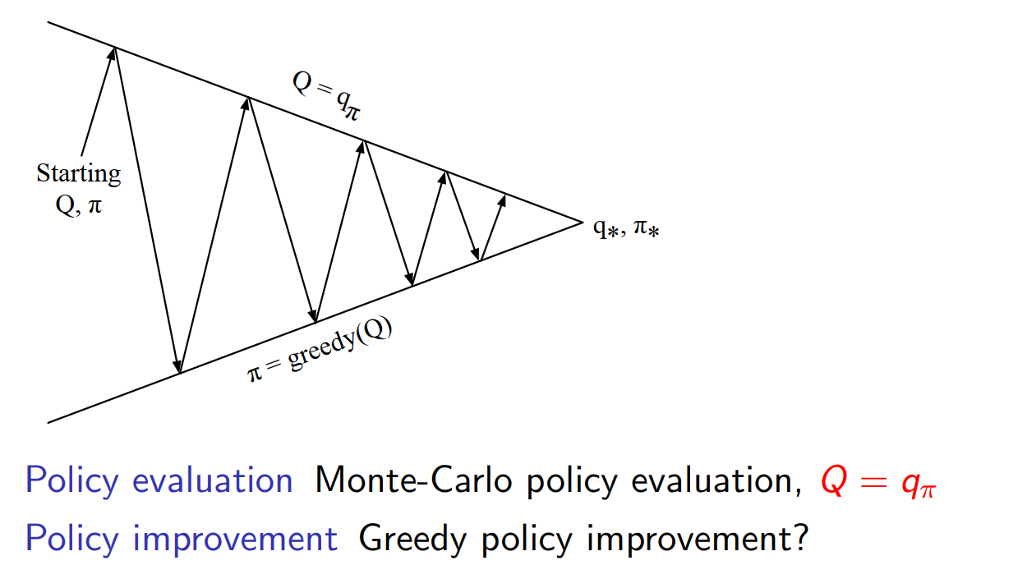
Policy Iteration using Action-Value Function
INTRODUCTION TO COMPUTING
Course Code: CCINCOM/L
Joseph Marvin R. Imperial
REINFORCEMENT LEARNING
NU College of Computing and Information Technologies
Course Code: CCRNFLRL

Slide 12
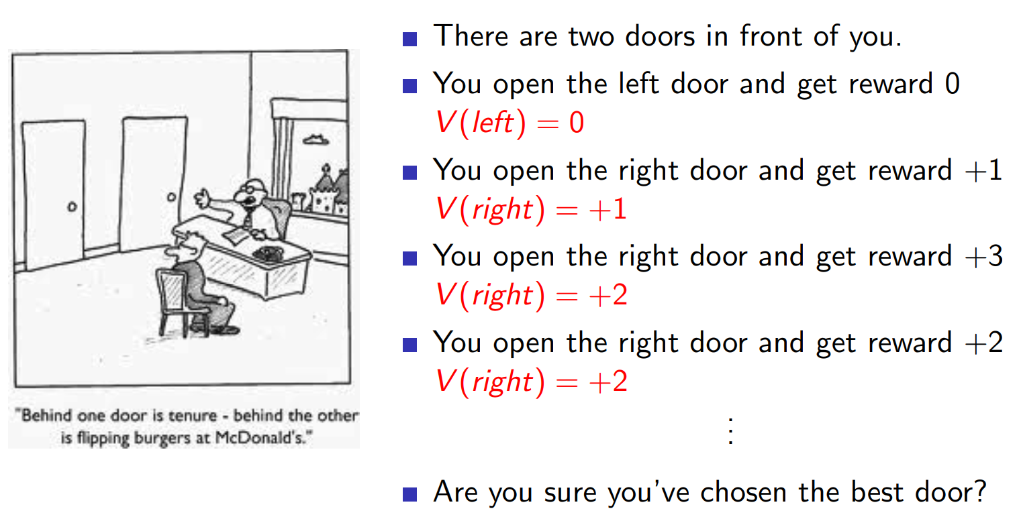
Greedy Action Selection
INTRODUCTION TO COMPUTING
Course Code: CCINCOM/L
Joseph Marvin R. Imperial
REINFORCEMENT LEARNING
NU College of Computing and Information Technologies
Course Code: CCRNFLRL

Slide 13
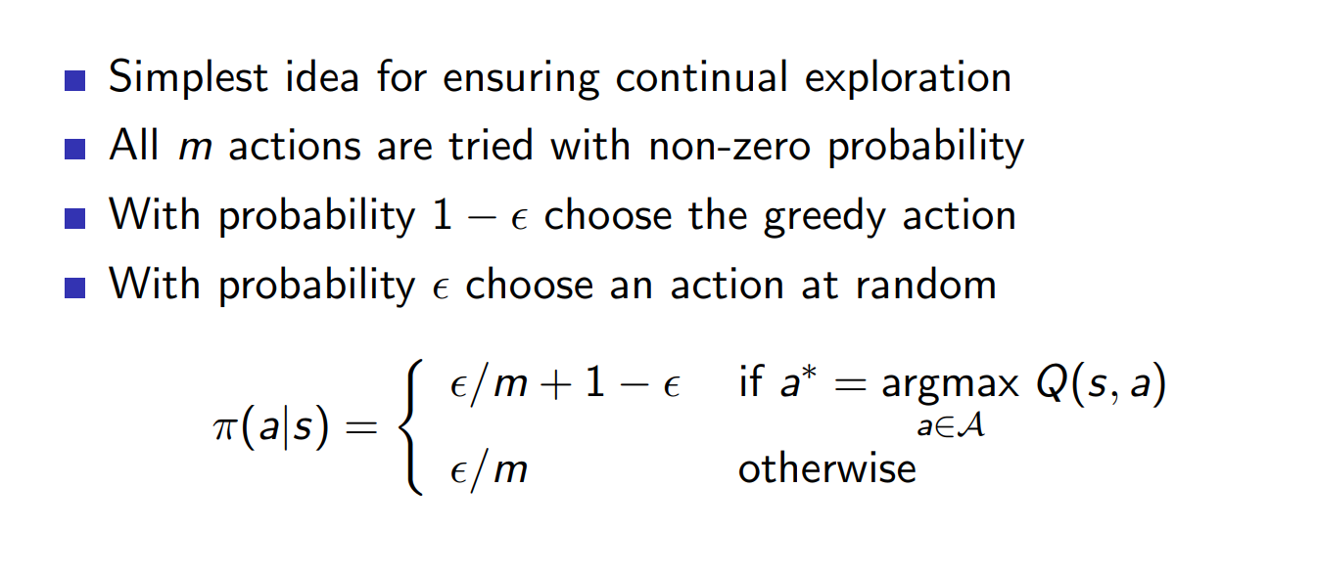
ε-Greedy Action Selection
INTRODUCTION TO COMPUTING
Course Code: CCINCOM/L
Joseph Marvin R. Imperial
REINFORCEMENT LEARNING
NU College of Computing and Information Technologies
Course Code: CCRNFLRL

Slide 14
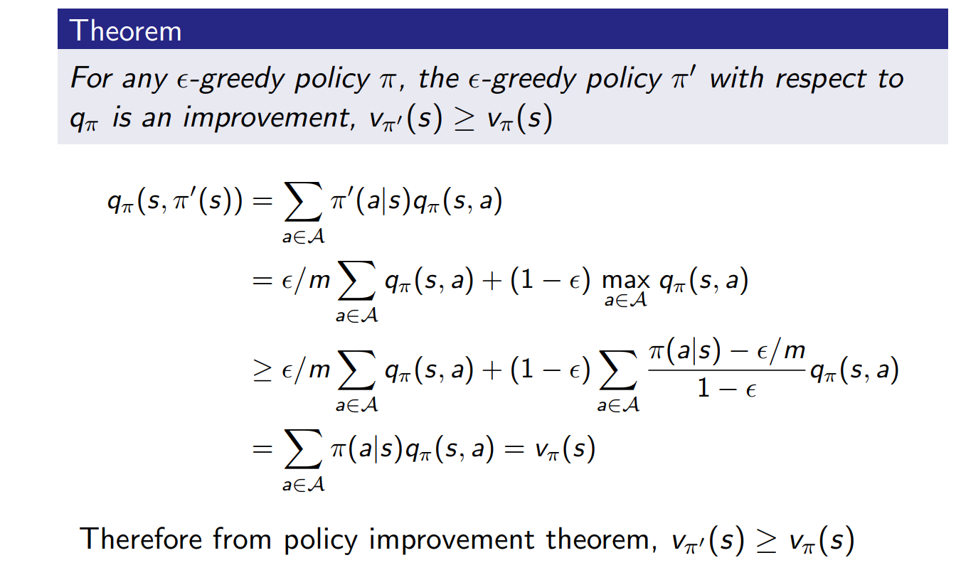
ε-Greedy Policy Improvement
INTRODUCTION TO COMPUTING
Course Code: CCINCOM/L
Joseph Marvin R. Imperial
REINFORCEMENT LEARNING
NU College of Computing and Information Technologies
Course Code: CCRNFLRL

Slide 15
Outline
INTRODUCTION TO COMPUTING
Course Code: CCINCOM/L
Introduction
On-Policy and Off-Policy
ε-Greedy Exploration
On-Policy
GLIE Monte-Carlo
SARSA
Off-Policy
Q-Learning
Joseph Marvin R. Imperial
REINFORCEMENT LEARNING
NU College of Computing and Information Technologies
Course Code: CCRNFLRL

Slide 16
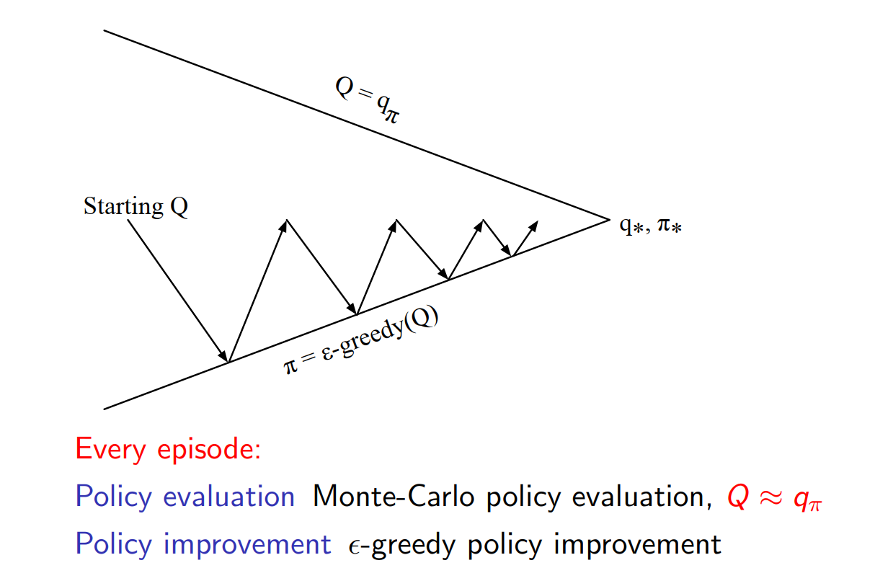
Monte-Carlo Control
INTRODUCTION TO COMPUTING
Course Code: CCINCOM/L
Joseph Marvin R. Imperial
REINFORCEMENT LEARNING
NU College of Computing and Information Technologies
Course Code: CCRNFLRL

Slide 17
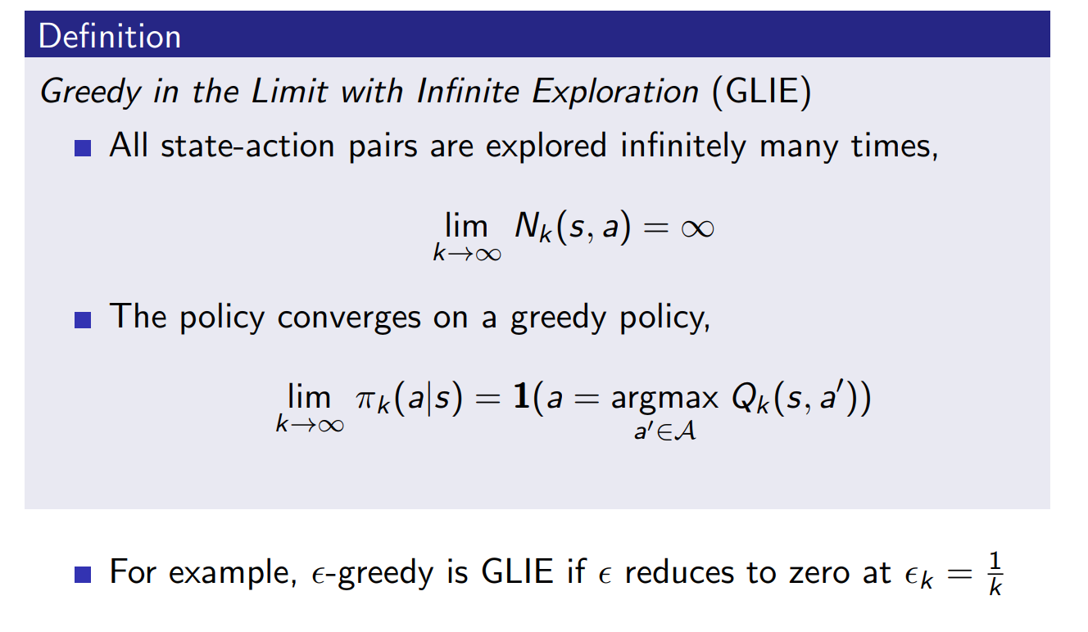
GLIE
INTRODUCTION TO COMPUTING
Course Code: CCINCOM/L
Joseph Marvin R. Imperial
REINFORCEMENT LEARNING
NU College of Computing and Information Technologies
Course Code: CCRNFLRL

Slide 18
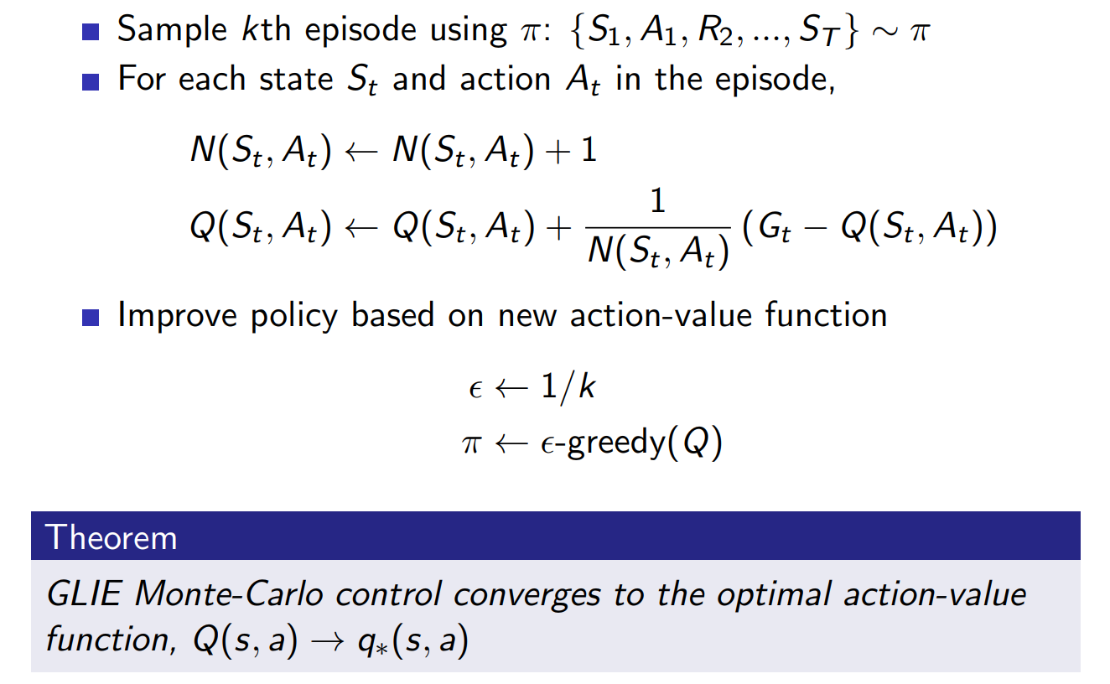
GLIE Monte Carlo Control
INTRODUCTION TO COMPUTING
Course Code: CCINCOM/L
Joseph Marvin R. Imperial
REINFORCEMENT LEARNING
NU College of Computing and Information Technologies
Course Code: CCRNFLRL

Slide 19
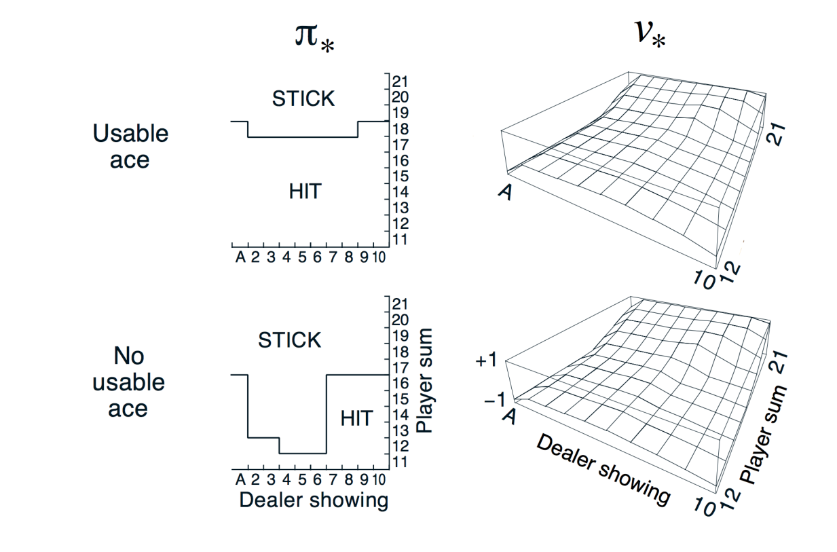
Monte Carlo Control in Blackjack
INTRODUCTION TO COMPUTING
Course Code: CCINCOM/L
Joseph Marvin R. Imperial
REINFORCEMENT LEARNING
NU College of Computing and Information Technologies
Course Code: CCRNFLRL

Slide 20
SARSA
INTRODUCTION TO COMPUTING
Course Code: CCINCOM/L
is an on-policy algorithm where in the current state S, an action A is taken and the agent gets a reward R and ends up in the next state S1 and take action A1 in S1, or in other words the tuple S, A, R, S1, A1.
New Q – Value Estimation
Current Q – Value Estimation
Learning Rate
Immediate Reward
Value of the next state-action pair
Current Q – Value Estimation
Joseph Marvin R. Imperial
REINFORCEMENT LEARNING
NU College of Computing and Information Technologies
Course Code: CCRNFLRL
Notes:
Start off with state S using action A
Sample from the environment to see what reward R we end up in and what state S we end up in.
We sample our own policy at that next state S1

Slide 21
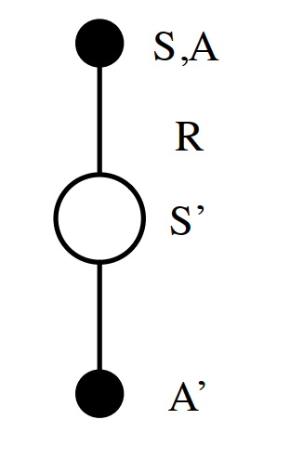
SARSA
INTRODUCTION TO COMPUTING
Course Code: CCINCOM/L
New Q – Value Estimation
Current Q – Value Estimation
Learning Rate
Immediate Reward
Value of the next state-action pair
Current Q – Value Estimation
Joseph Marvin R. Imperial
REINFORCEMENT LEARNING
NU College of Computing and Information Technologies
Course Code: CCRNFLRL
Notes:
Start off with state S using action A
Sample from the environment to see what reward R we end up in and what state S we end up in.
We sample our own policy at that next state S1

Slide 22
SARSA
INTRODUCTION TO COMPUTING
Course Code: CCINCOM/L
Initialize the action-value estimates Q(s, a) to some arbitrary values.
Set the initial state s.
Choose the initial action a using an epsilon-greedy policy based on the current Q values.
Take the action a and observe the reward r and the next state s’.
Choose the next action a’ using an epsilon-greedy policy based on the updated Q values.
Update the action-value estimate for the current state-action pair using the SARSA update rule:
Q(s, a) = Q(s, a) + alpha * (r + gamma * Q(s’, a’) – Q(s, a))
Joseph Marvin R. Imperial
REINFORCEMENT LEARNING
NU College of Computing and Information Technologies
Course Code: CCRNFLRL

Slide 23
Outline
INTRODUCTION TO COMPUTING
Course Code: CCINCOM/L
Introduction
On-Policy and Off-Policy
ε-Greedy Exploration
On-Policy
GLIE Monte-Carlo
SARSA
Off-Policy
Q-Learning
Joseph Marvin R. Imperial
REINFORCEMENT LEARNING
NU College of Computing and Information Technologies
Course Code: CCRNFLRL

Slide 24
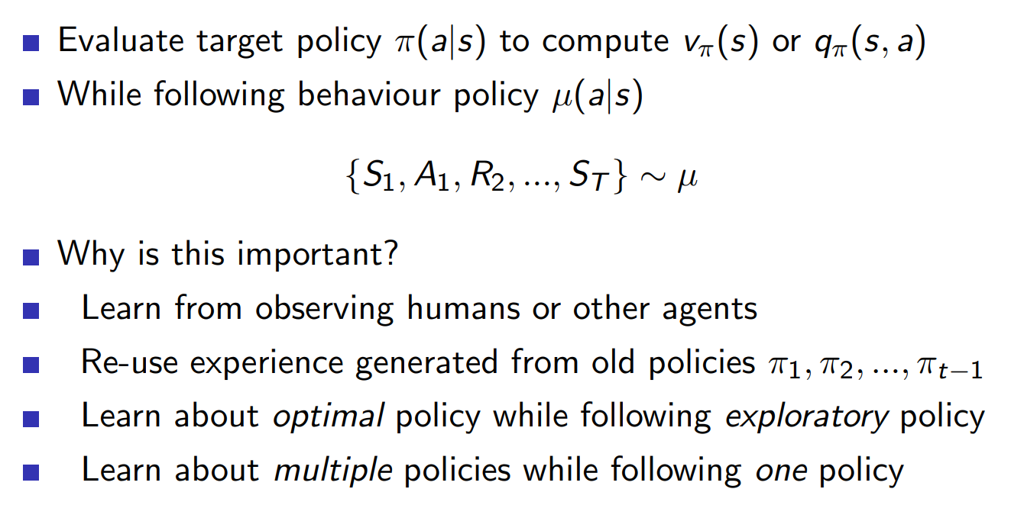
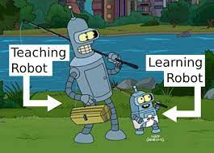
Off-Policy Learning
INTRODUCTION TO COMPUTING
Course Code: CCINCOM/L
Joseph Marvin R. Imperial
REINFORCEMENT LEARNING
NU College of Computing and Information Technologies
Course Code: CCRNFLRL

Slide 25
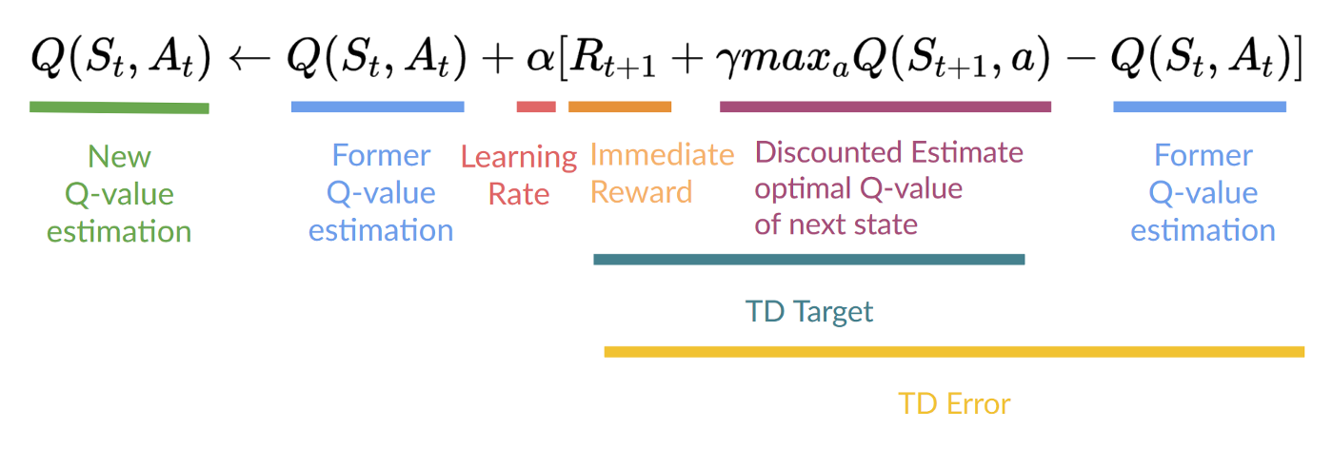
Q-Learning
INTRODUCTION TO COMPUTING
Course Code: CCINCOM/L
Is an off-policy value-based method that uses a TD approach to train its action-value function
Joseph Marvin R. Imperial
REINFORCEMENT LEARNING
NU College of Computing and Information Technologies
Course Code: CCRNFLRL

Slide 26
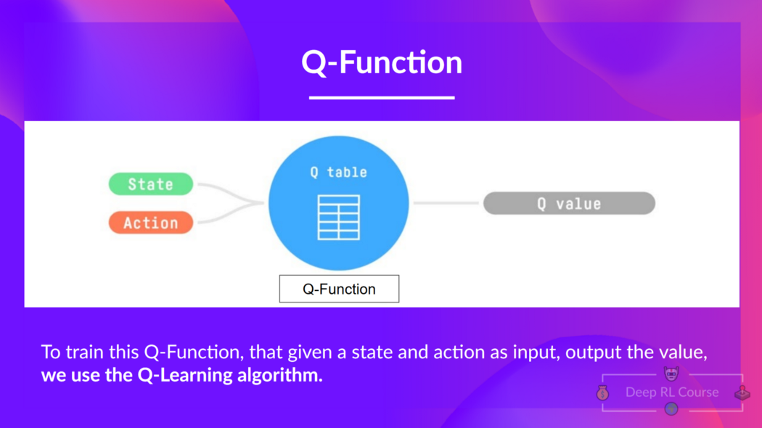
Q-Learning
INTRODUCTION TO COMPUTING
Course Code: CCINCOM/L
Joseph Marvin R. Imperial
REINFORCEMENT LEARNING
NU College of Computing and Information Technologies
Course Code: CCRNFLRL

Slide 27
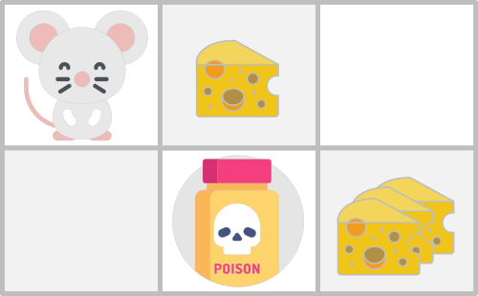
Q-Learning
INTRODUCTION TO COMPUTING
Course Code: CCINCOM/L
Joseph Marvin R. Imperial
REINFORCEMENT LEARNING
NU College of Computing and Information Technologies
Course Code: CCRNFLRL

Slide 28
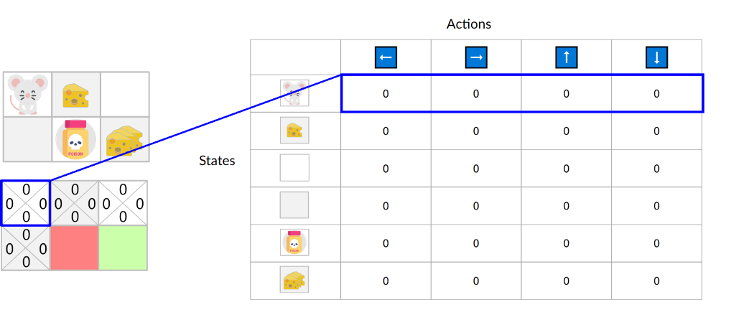
Q-Learning
INTRODUCTION TO COMPUTING
Course Code: CCINCOM/L
Q-Table is just a simple lookup table where we calculate the maximum expected future rewards for action at each state
This table will guide us to the best action at each state.
Joseph Marvin R. Imperial
REINFORCEMENT LEARNING
NU College of Computing and Information Technologies
Course Code: CCRNFLRL

Slide 29
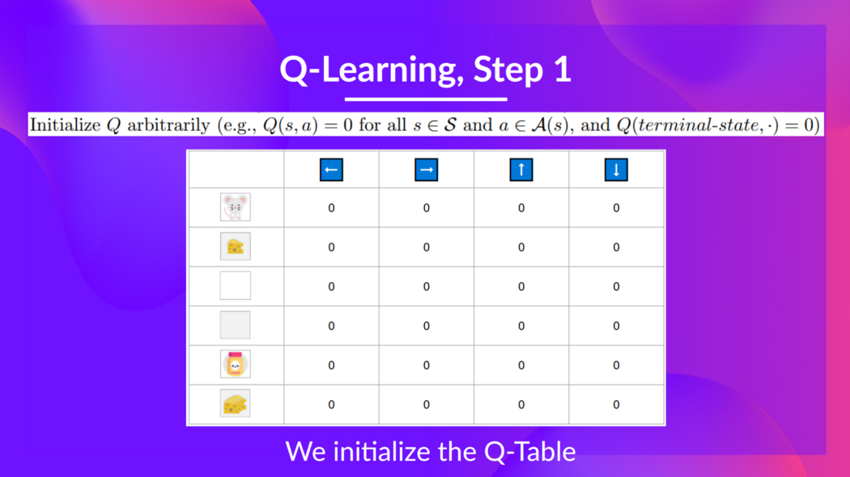
Q-Learning
INTRODUCTION TO COMPUTING
Course Code: CCINCOM/L
Joseph Marvin R. Imperial
REINFORCEMENT LEARNING
NU College of Computing and Information Technologies
Course Code: CCRNFLRL

Slide 30
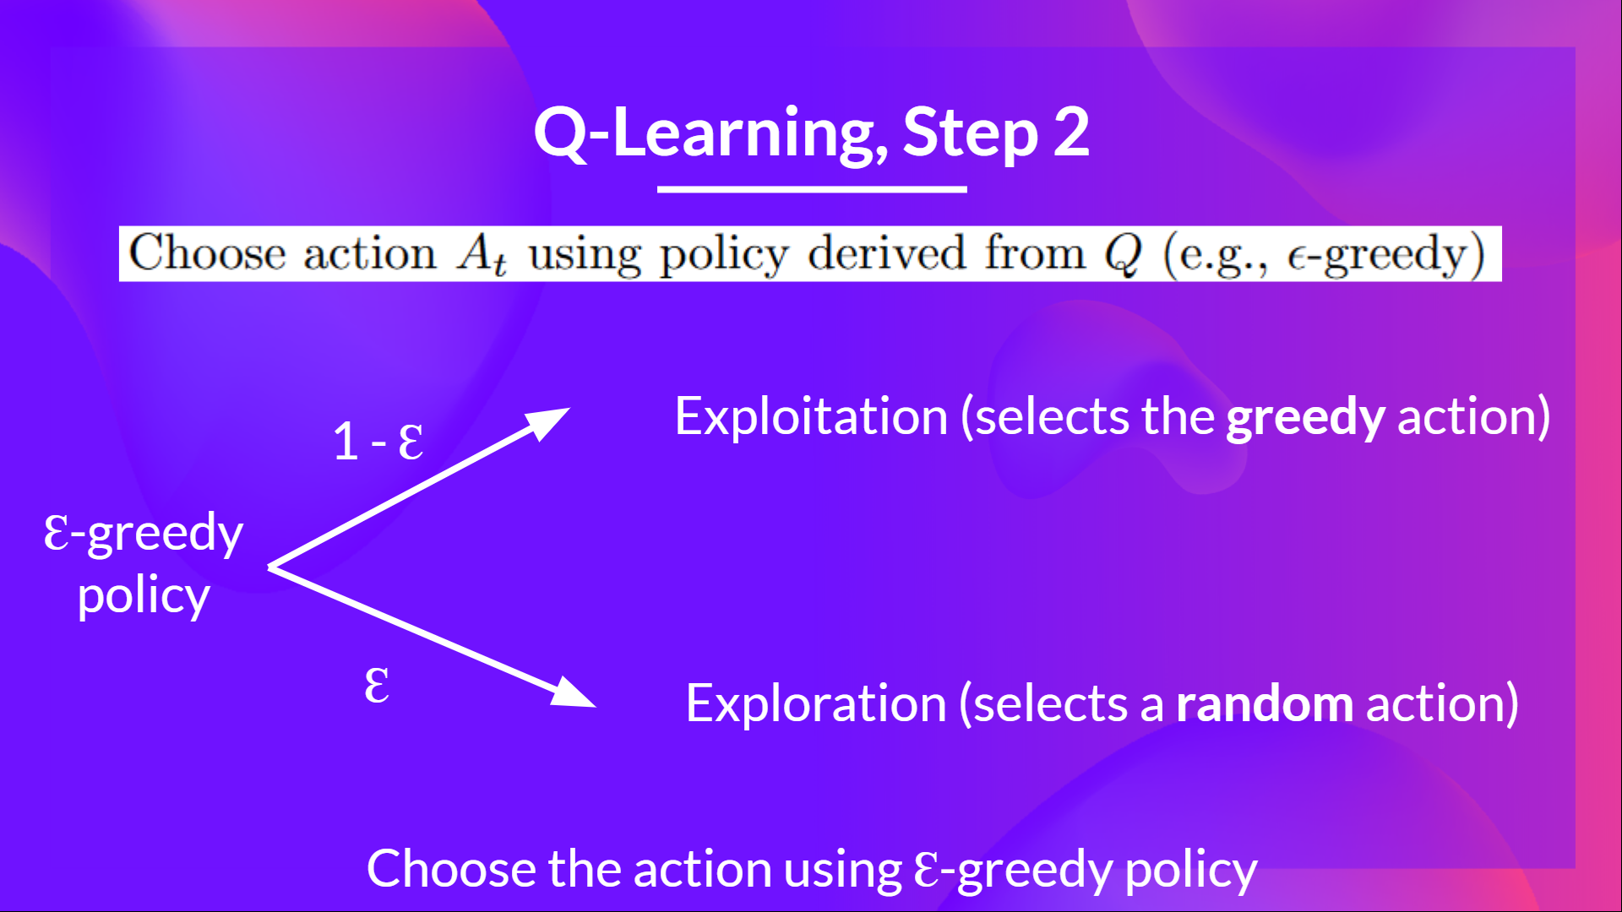
Q-Learning
INTRODUCTION TO COMPUTING
Course Code: CCINCOM/L
Joseph Marvin R. Imperial
REINFORCEMENT LEARNING
NU College of Computing and Information Technologies
Course Code: CCRNFLRL

Slide 31

Q-Learning
INTRODUCTION TO COMPUTING
Course Code: CCINCOM/L
Joseph Marvin R. Imperial
REINFORCEMENT LEARNING
NU College of Computing and Information Technologies
Course Code: CCRNFLRL

Slide 32
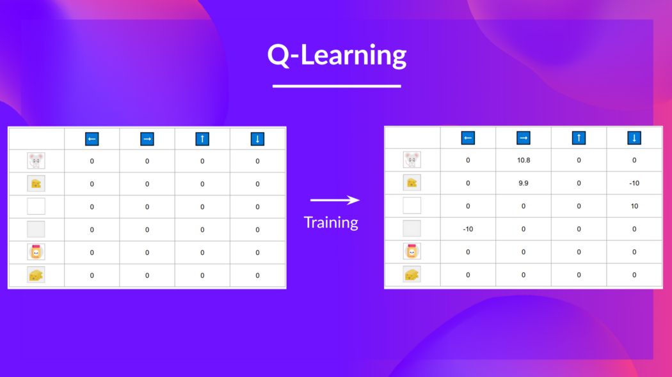
Q-Learning
INTRODUCTION TO COMPUTING
Course Code: CCINCOM/L
Joseph Marvin R. Imperial
REINFORCEMENT LEARNING
NU College of Computing and Information Technologies
Course Code: CCRNFLRL

Slide 33
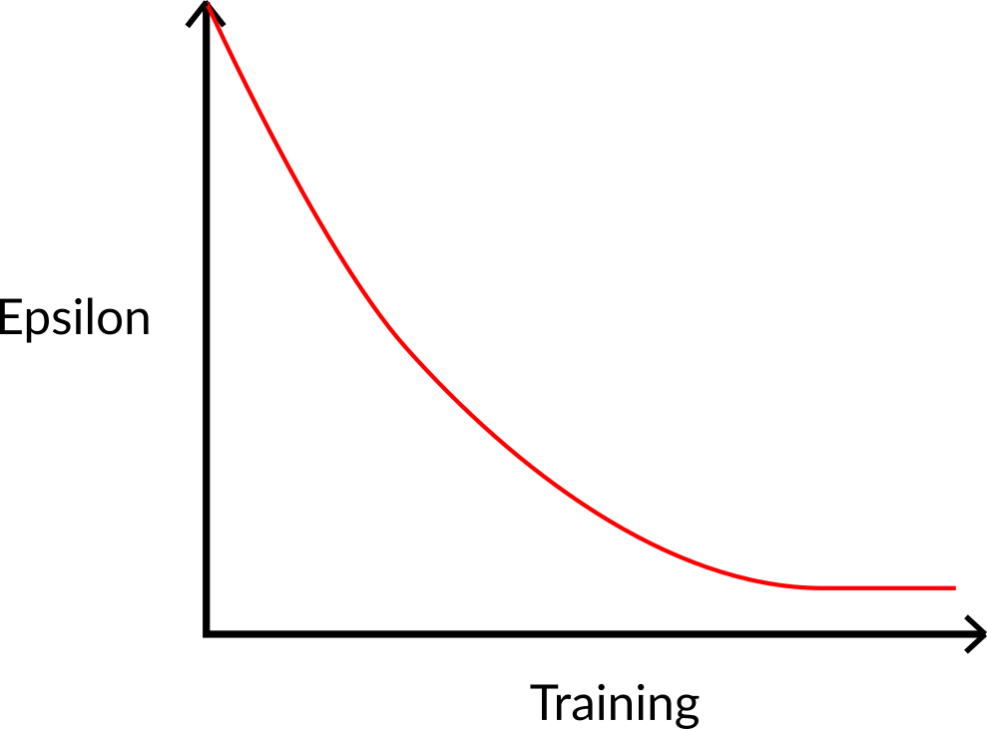
Q-Learning
INTRODUCTION TO COMPUTING
Course Code: CCINCOM/L
Joseph Marvin R. Imperial
REINFORCEMENT LEARNING
NU College of Computing and Information Technologies
Course Code: CCRNFLRL

Slide 34
Q-Learning
INTRODUCTION TO COMPUTING
Course Code: CCINCOM/L
Trains a Q-function (an action-value function), which internally is a Q-table that contains all the state-action pair values.
Given a state and action, our Q-function will search its Q-table for the corresponding value.
When the training is done, we have an optimal Q-function, which means we have optimal Q-table.
And if we have an optimal Q-function, we have an optimal policy since we know the best action to take at each state.
Joseph Marvin R. Imperial
REINFORCEMENT LEARNING
NU College of Computing and Information Technologies
Course Code: CCRNFLRL

Slide 35
References
INTRODUCTION TO COMPUTING
Course Code: CCINCOM/L
Images are licensed with Creative Commons. Can use without citing.
Prof. Emma Brunskill’s slides (CS234RL). https://web.stanford.edu/class/cs234/slides/lecture1.pdf
David Silver’s slides. https://www.davidsilver.uk/wp-content/uploads/2020/03/intro_RL.pdf
Review in Probability, Intro to RL Concepts
Joseph Marvin R. Imperial
REINFORCEMENT LEARNING
NU College of Computing and Information Technologies
Course Code: CCRNFLRL

